Slide 1
Overall Equipment Effectiveness
Improve Process & Equipment Reliability
Improve Process Control & Capability

Slide 2

Other Modules In This Series:
5S
Standard Work
Total Productive Maintenance (TPM)
Administrative Lean
Cell Design/ Production Preparation Process (3P)
Kaizen
Kanban
Problem Solving
Poka Yoke Quality Systems
Transaction Process Improvement (TPI)
Cause & Effect Diagram with the Additions of Cards (CEDAC)
Single Minute Exchange of Dies (SMED)
Value Stream Mapping (VSMi®)
Visual Management
Managing Daily Process Excellence
For More Information Please Contact:
Mark DeLuzio, President and CEO
+1.860.234.0915
mark.deluzio@leanhorizons.com
Strategically Creating Value Through the Elimination of Waste

Slide 3
This document contains confidential
and proprietary information owned
by Lean Horizons Consulting, LLC.
Any disclosure, use, copying or
distribution of this information without the express written consent of Lean Horizons Consulting is strictly prohibited.

Slide 4
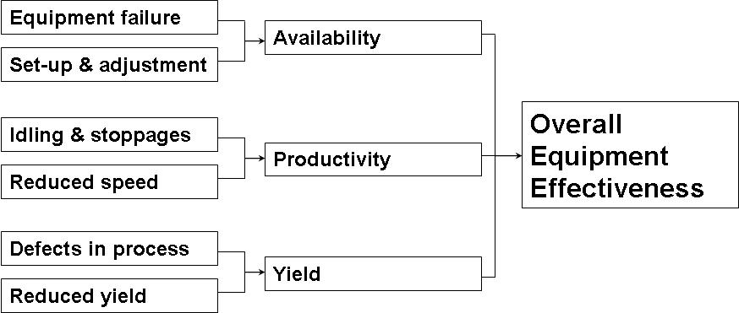
Overall Equipment Effectiveness
OEE = Productivity * Availability * Yield

Slide 5
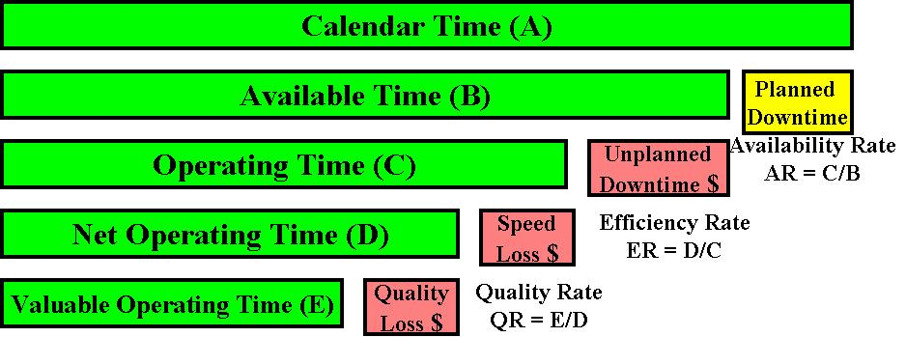
OEE Defined
Overall Equipment Effectiveness
World Class Targets
Availability Rate = 90%
Efficiency Rate = 95%
Quality Rate = 99%
OEE = 89%
Target Opportunities = $
Notes:
OEE deals in time and time can be directly correlated to money.
The chart explains how the OEE calculation is made and also clearly shows the opportunities for improvement in red.
The organization has strategic goals, focus and OEE as the key indicator.
Now they need the tools to attack the target opportunities and make improvements.

Slide 6
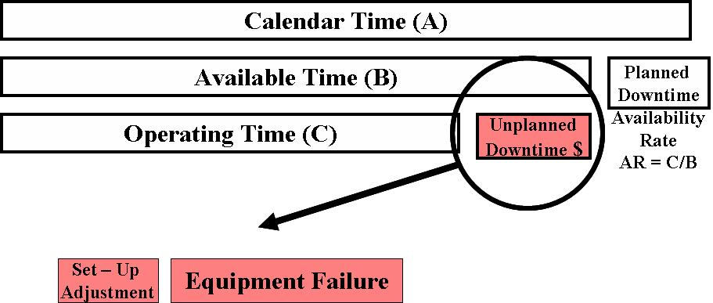
Unplanned Downtime
World Class Targets
Availability Rate = 90%
Efficiency Rate = 95%
Quality Rate = 99%
OEE = 89%
Notes:
Let’s address each opportunity in more detail.
The first component is Unplanned Downtime. It is measured as the Availability Rate.
Set-up / Adjustment and Equipment Failure make up this loss.
Availability is also know as % uptime.

Slide 7
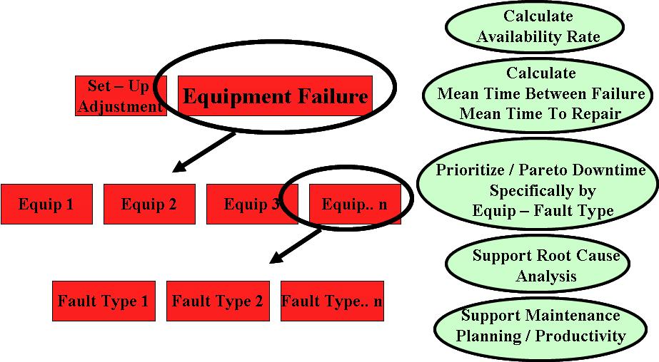
Unplanned Downtime
Notes:
We can specifically target Equipment Failure.
Equipment failure can be prioritized and analyzed by component and specific fault type.
Condition-based maintenance and predictive maintenance methods can be applied.

Slide 8
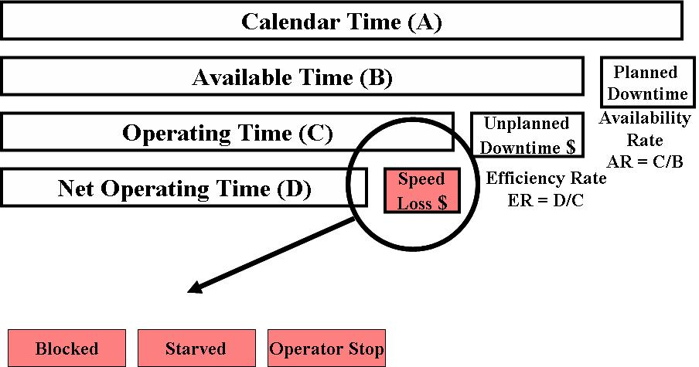
Speed Loss
World Class Targets
Availability Rate = 90%
Efficiency Rate = 95%
Quality Rate = 99%
OEE = 89%
Notes:
The next opportunity is speed loss. It is measured as the Efficiency Rate.
This example shows some common types of efficiency loss.
Efficiency is lost if the process is blocked by a subsequent process.
Efficiency is lost if the process is starved from a previous process.
Efficiency is lost if operators stop the process for any reason.

Slide 9
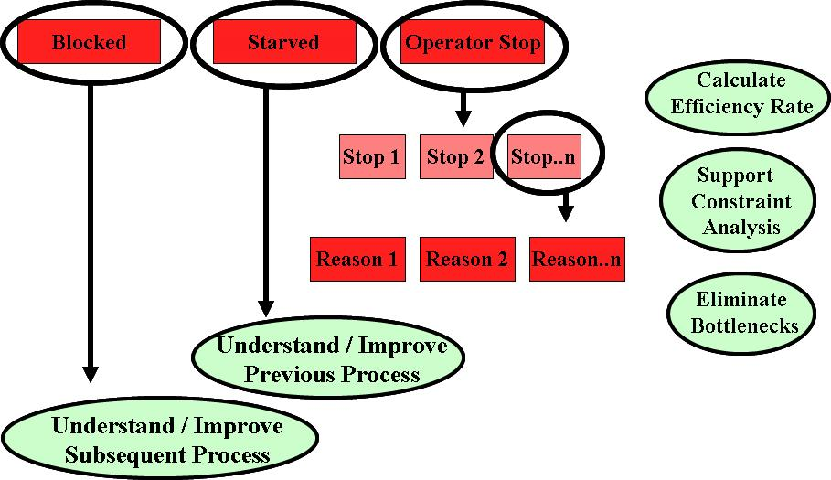
Speed Loss
Notes:
We can specifically target operator stops and reasons.
Stops can be prioritized / analyzed / improved.
Constraints can be analyzed and bottlenecks can be eliminated.

Slide 10
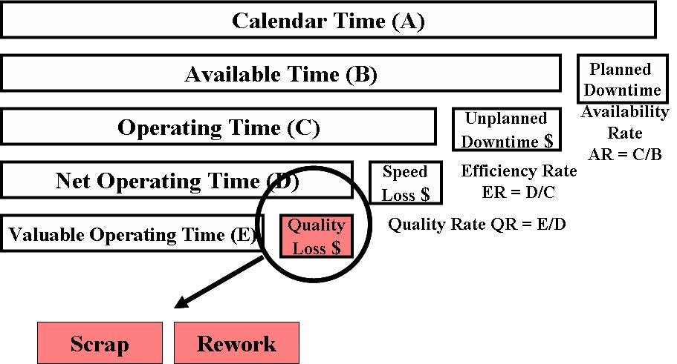
Quality Losses
World Class Targets
Availability Rate = 90%
Efficiency Rate = 95%
Quality Rate = 99%
OEE = 89%
Notes:
The third component is Quality Loss. It is measured as the Quality Rate or Yield.
Scrap and Rework are the measurable components of Quality Loss.

Slide 11
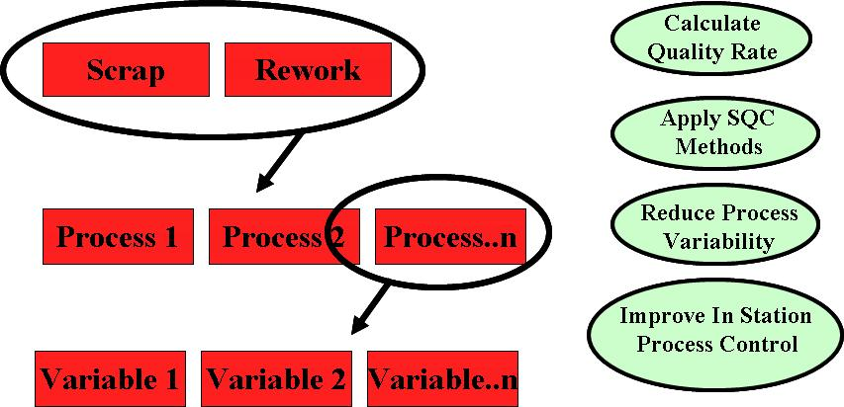
Quality Losses
Notes:
Scrap and Rework can be reduced with better process control and capability.
In Station Process Control (ISPC) should be emphasized. Testing and inspection data can be directly correlated to ISPC.
Quality losses can be prioritized and analyzed by process and specific process variable.
Variability reduction teams can be focused and effective.

Slide 12
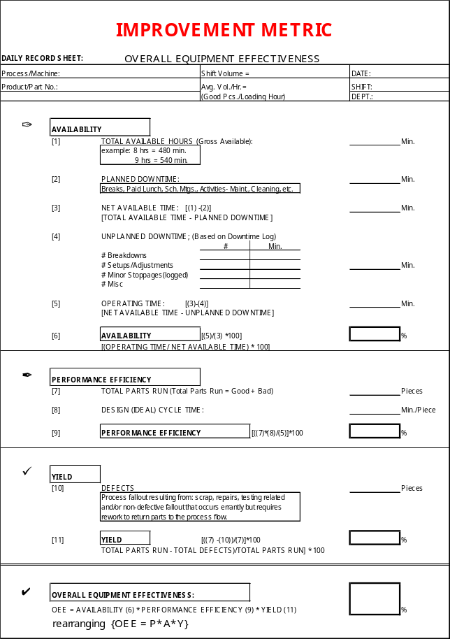
Improvement Metric

Slide 13
OEE Audit
Is there enough information about the time losses to solve problems?
Is the OEE data collection sheet simple for the operators to calculate?
Who collates the information?
Are there OEE improvement action plans?
Have responsibilities been assigned for each action?
Have the people got enough time to calculate the OEE?
Do the people believe the OEE figure?

Slide 14
OEE Audit
Do the people know the OEE value for their line?
Do the people know the OEE goal?
How exact is the OEE data?
Does every shift and department calculate the OEE in the same way? How do you make sure?
Is there a standard for the data collection?
Is there an audit to check the OEE data?
Are the real problems shown by the data?
Do the people understand the importance of OEE?

Slide 15
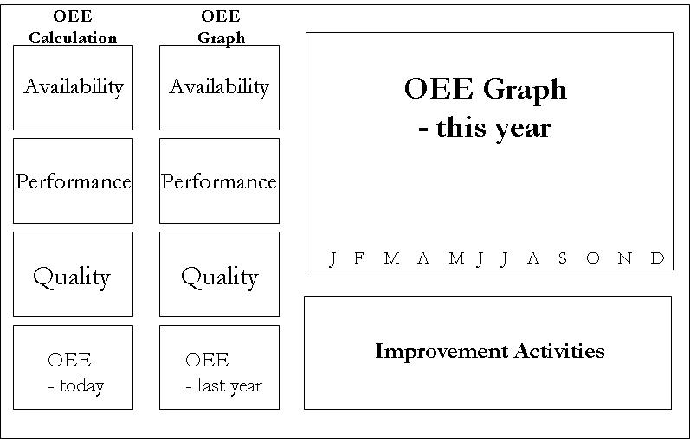
OEE Board
Set Targets and Monitor Progress

Slide 16
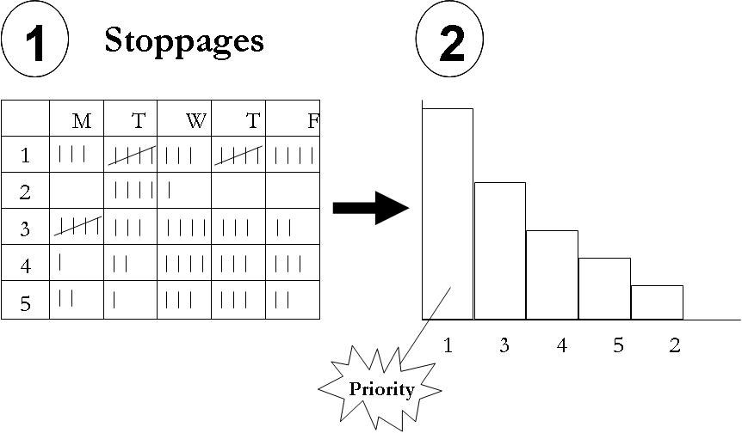
Understand Current State – Collect Data

Slide 17
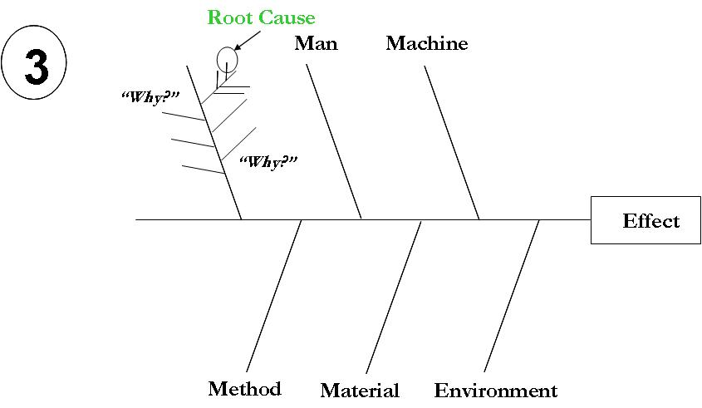
Find the Root Cause of the Losses

Slide 18
Summary – Objectives
Improve
  Quality
  Customer Satisfaction
  Productivity
  Process & Equipment Reliability
  Process Capability
Reduce Cost
Notes:
Every organization has clear objectives.
People must be empowered and focused.
There must be a trusted way to measure and “One version of the truth.”
The proper tools must be provided if you want more than “just low hanging fruit.”

Slide 19
Other Modules In This Series:
5S
Standard Work
Total Productive Maintenance (TPM)
Administrative Lean
Cell Design/ Production Preparation Process (3P)
Kaizen
Kanban
Problem Solving
Poka Yoke Quality Systems
Transaction Process Improvement (TPI)
Cause & Effect Diagram with the Additions of Cards (CEDAC)
Single Minute Exchange of Dies (SMED)
Value Stream Mapping (VSMi®)
Visual Management
Managing Daily Process Excellence
For More Information Please Contact:
Mark DeLuzio, President and CEO
+1.860.234.0915
mark.deluzio@leanhorizons.com
Strategically Creating Value Through the Elimination of Waste

